Slide 1
Boarding up windows
a better approach to controlling Win10

Slide 2
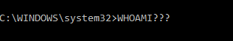
Speaker bio
Am Pookiebear:
@THEpooki3bear
https://github.com/pooki3bear/

Slide 3
Opinions and ideas expressed here are not that of my employer (past or previous), nor are they even mine.

Slide 4
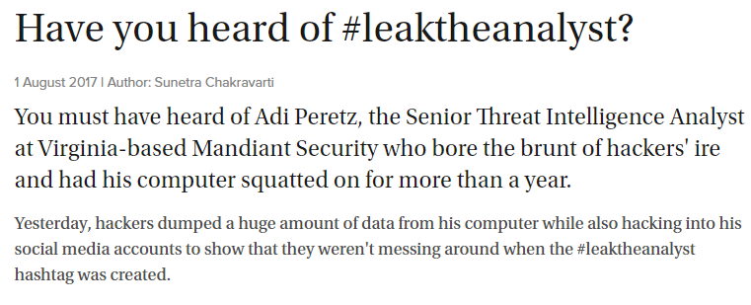
“Real hackers don’t use windows”

Slide 5
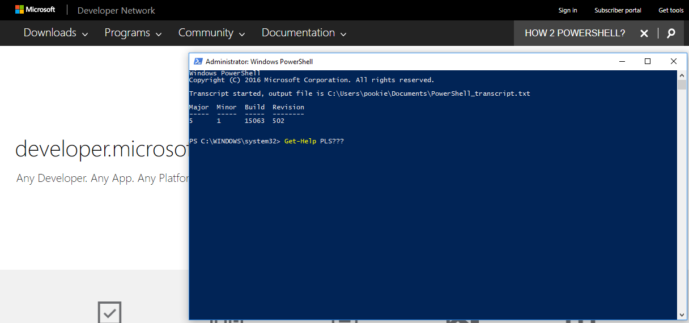
Shit, I use windows…

Slide 6
But pookie, Wat 4?

Slide 7
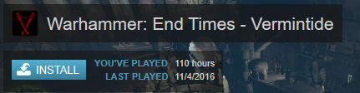
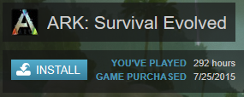
Outlet 4 nerd rage. Kill rats, kill dinos

Slide 8
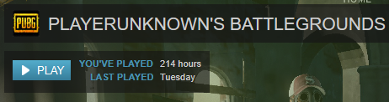
Kill nubs

Slide 9
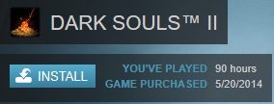
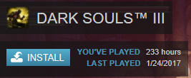
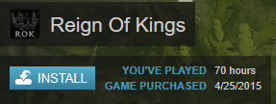
Slay kings, ignite embers, got gud

Slide 10
I’m also family helpdesk

Slide 11
Cool we get it…
I’ll bet you or someone you know haz some info on windows worth protecting, or you use windows to access something important.

Slide 12
Consumer threat model

Slide 13
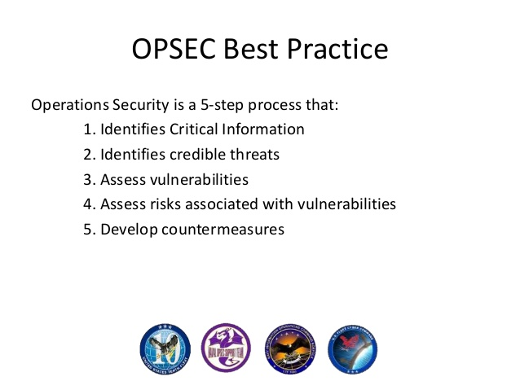

Slide 14
Identify Critical Information / Wat Protect?
Analyze Threats / Protect from Wat?
Discover Vulnerabilities / Protect where?
Assess Risks / Wat Lose?
Develop Countermeasures / Work on Protect

Slide 15
Identify Critical Information
The stuff on my PC!
Need to maintain high integrity to prevent tampering

Slide 16
Analyze Threats
Who after me?

Slide 17
!!!disclaimer!!!
The following brief analysis of threats are ranked in Pookie’s perceived likelihood from least to most over the general population.
I do not have %’s but it is also proportional to resource cost of the hypothetical actor.
Just treat this whole talk as pure conjecture.

Slide 18
Zomg apt!
Fingers crossed this isn’t the case, still we should be better prepared than the average Joe.

Slide 19
$3letter wants your wow account

Slide 20
trolls like me?

Slide 21
Jump on someone’s wifi
MS17-010 they box
????
Profit!!!

Slide 22
Go to your hommies house, small office, restaurant
Plug in ducky, lanturtle, $USB_ATTACK…
????
Profit!!!

Slide 23
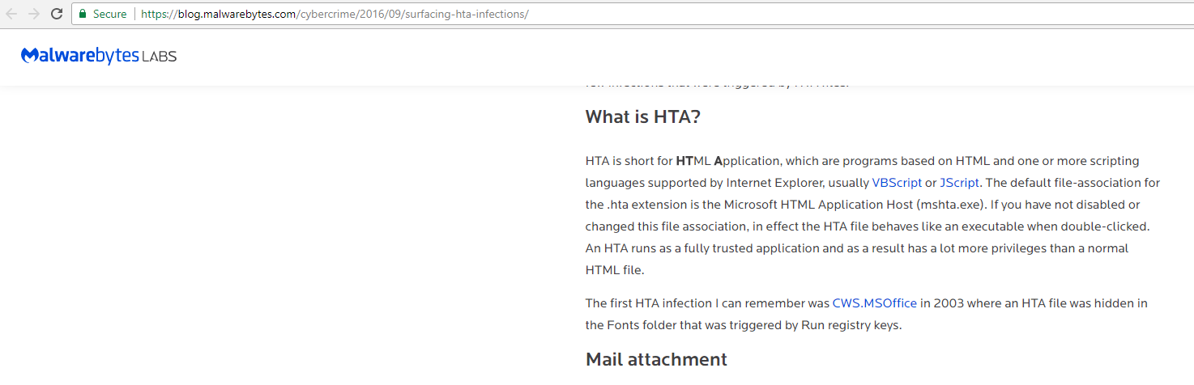
ransomware / Drive-by BS

Slide 24
Ransomware commonalities
Delivered via web download or email attachment
Poorly configured view settings in explore.exe or icon tricks are relied upon for user interaction, i.e. known file extensions are hidden
Old script interpreters are leveraged as loaders; mshta (iexplore.exe), cscript, wscript
Ultimately a binary in a non-standard location is executed

Slide 25
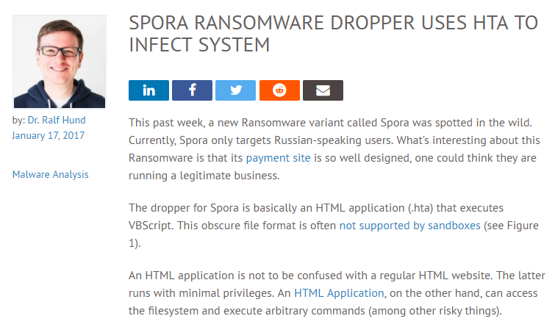
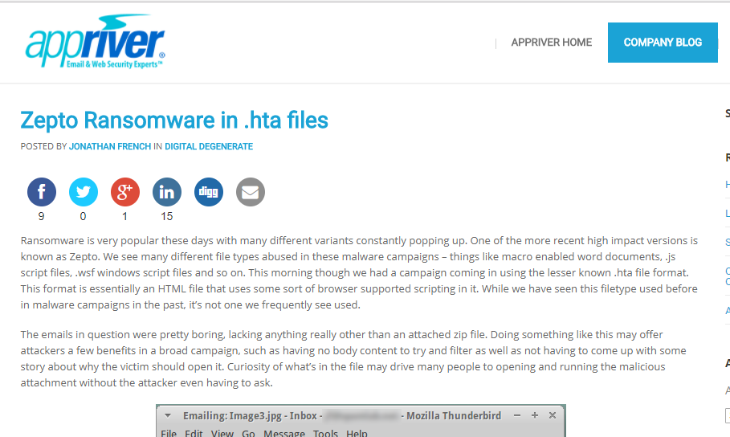
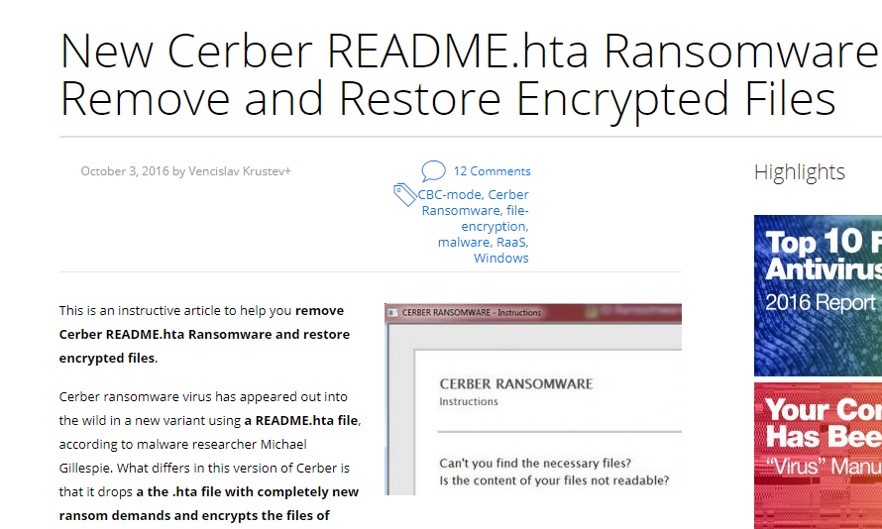
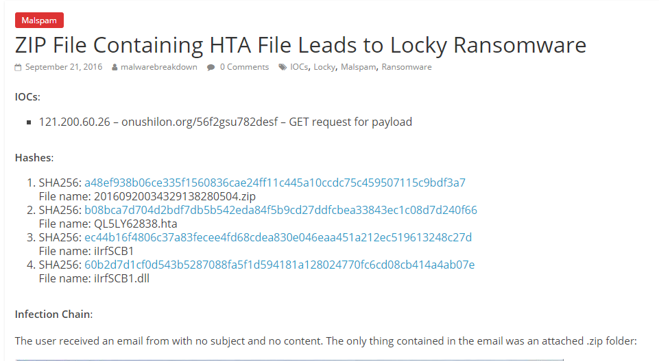

Slide 26
Discover Vulnerabilities
Key assumption is that user has fully patched Win10, not too much to ask
Currently not too bad unless (DEFINITELY) $3Letter has more bugs stockpiled
We assume default home network gateway configuration for firewall

Slide 27
Look for a future Pookie project that will assist with vulnerability detection on the home LAN, as well as active network defense :D

Slide 28
Assess Risks
Lose $Account(s) from long-term troll
Lose all your files to ransomware
Electricity cost and slowness when you someone’s bot

Slide 29
Develop Countermeasures

Slide 30
key assumptions
moderately technical user can run it - 'gamer skill‘ – willing to change minor workflow aspects
fully patched win 10
I don't manage your AV, nor that of an enterprise that might want this

Slide 31
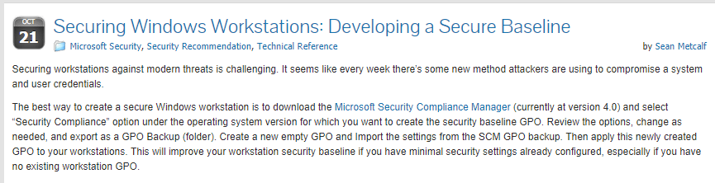
so how?
http://adsecurity.org/?p=3299

Slide 32
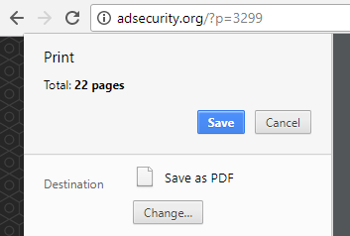
Great read, Awesome references but…

Slide 33
How can address realistically?

Slide 34
NSA HSB Exists
https://github.com/iadgov/Secure-Host-Baseline

Slide 35
Half-heartedly tried it
Huge code review, factored out junk parts like .gov certs, activeclient, whatever
Hard to use GPOs for a consumer, or even in enterprise with tech debt
Pretty much bricked my VM – Device Guard was factored out so idunno how
Unable to locate a DoD employee that can even use it…

Slide 36
Lets be more reasonable Approach

Slide 37
Technical objectives
Configure windows well
Configure user interface properly
Mitigate mimikatz, keep my OS passwords mine
Mitigate .\Responder
Mitigate common malware attacks
Keep big brother out
Log everything

Slide 38

Configure user interface properly
Disables some win10 start annoyances
Shows hidden files
Always shows file extension
Sets risky filetypes to execute by default from notepad, sublime, or N++ if you have. - .com.bat.js.hta.reg.scr.vbs.whatever
These are always manually set by me on any system I touch :’(

Slide 39
Mitigate mimikatz, keep my OS passwords mine
Turns of password storage in wdigest
LSASS integrity settings
More configs in a sec that helps overall

Slide 40



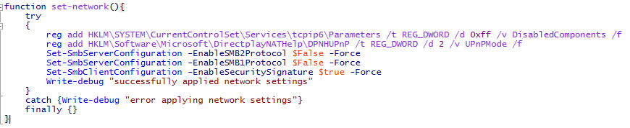
Mitigate .\Responder .etc
No one home
Netbios, SMB, LLMNR, mDNS,wpad,UPNP

Slide 41
Mitigate common malware attacks
I R OSCP nub but know 2 things
Memory protections work against sploits
Restricted execution environment is pain
Approach must at least consider 0days
Approach must have basic signature AV control
Approach should consider application whitelisting

Slide 42
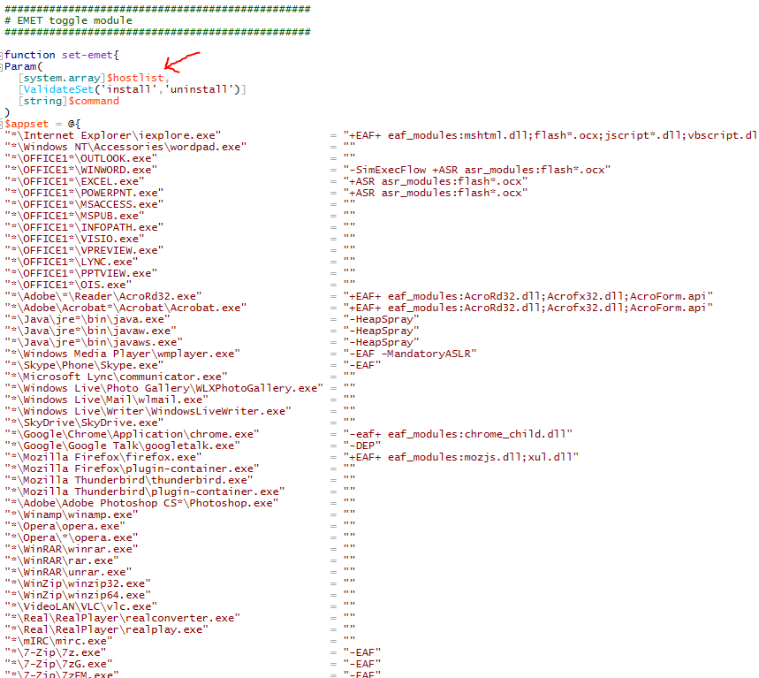

Slide 43
Emet
Can control memory protection options for most common applications, which are also the ones most people use sploits for
Supposed to be collapsed into the OS by now
Hey Microsoft, I’m still waiting on the Cortana skills SDK since Feb 2017
Maybe that’s what they want you to think while the $3letter uses a few more reliable MS17-010 type sploits

Slide 44
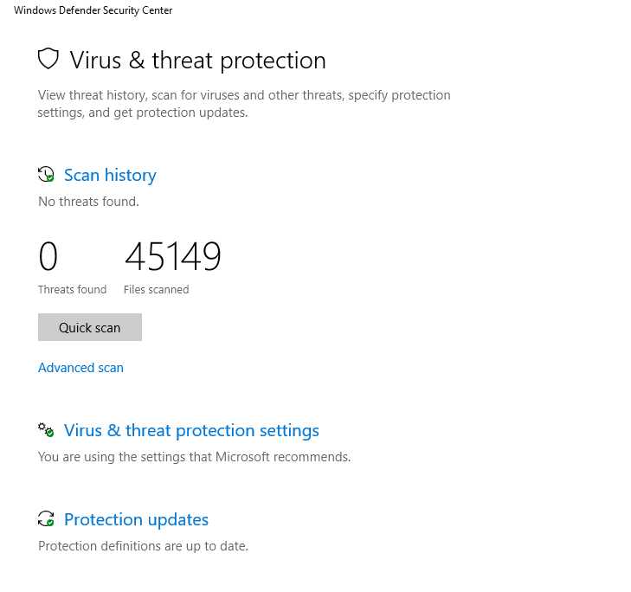

Slide 45
wut
Windows Defender is actually OK, they seem to have an acceptable signature database
Scans files on access
Picks up most malicious powershell I can seem to generate with kali tools
https://github.com/pooki3bear/trollsrc for fun if you want to troll and have the same problem.
FREE

Slide 46
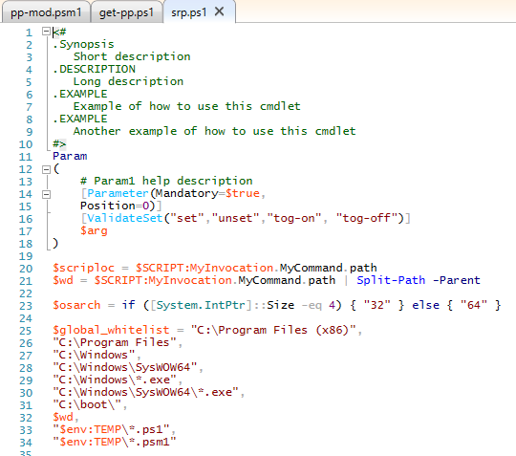

Slide 47
Software restriction policy
Only free control for app whitelisting available across all Win10 versions
Pretty robust, under-documented
I refactored the idea from someone else’s app
And then some hacky attempts to configure it for you in an ok manner

Slide 48
Keep in mind I am an awful programmer
And at times this may be somewhat questionably implemented
And unoptimized
And overall awful
But so far works for me

Slide 49
SRP
Scans all local hard drives and puts it in a big object
Searches that object for paths with executables except for program files, windows, documents and downloads
Prog and win are global whitelist
Docs and downloads should never be allowed
Takes these paths and conducts a hacky attempt to compare them all and reduce the over length. It greatly optimizes the rules but can be improved.
Future version will leverage accesschk.exe to remove these candidates based off user permissions

Slide 50
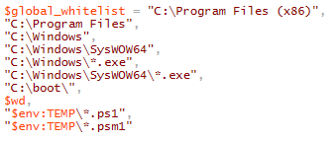
Srp cont
Global whitelist
Contains Windows critical system files
Contains program files where apps SHOULD live
Contains the directory where you execute the script from and the users %TEMP%
This should not be a problem the as user is admin, we intend to keep integrity

Slide 51
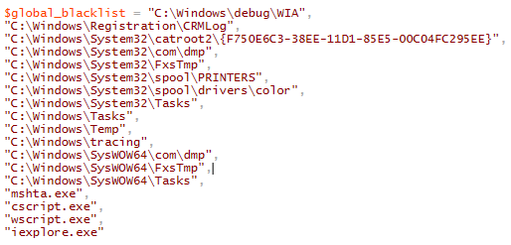
Srp cont
Global Blacklist
Block some BS temp dirs.
Block bad interpreters

Slide 52
Workflow to manage
Nothing regarding the overall system state should change without direct admin intervention thru UAC escalation.
Most people are capable of following this with just a little effort
Target audience definitely should be capable
Model works better with user-level account used on a daily basis with a separate admin password
Model still has positive benefits without account separation

Slide 53
Normal operation
Can’t
run anything not in whitelist
install new stuff
No new drivers
not even thingys that can emulate keyboards and mouses
If you can make your thingy emulate another copy of my keyboard I will be impress (Corsair K70 hit me on twitter)
Run most scripts
powershell can run, if run by non-admin it will open in constrained language mode which prevents dll loading and add-type stuff. This also prevents stuff like katz from loading.

Slide 54
Normal operation cont
Can!
Update windows
Update existing applications (as long as you don’t execute installer from \downloads)
Use devices for any drivers you have trusted already in the system baseline
not even thingys that can emulate keyboards and mouses
If you can make your thingy emulate another copy of my keyboard I will be impress (Corsair K70 hit me on twitter)
Use your already installed apps which should be everyone’s workflow on their primary machine

Slide 55
Toggle it off
Right now desktop shortcut that elevates thru UAC with the right options calling srp.ps1
Toggles settings off, old interpreters are available, can install stuff with admin approval, can new device, whatevers.

Slide 56
Toggle it on
Another desktop shortcut
Turns on all aspects of the SRP mentioned
Plan to implement this in a winform
UX contribs greatly appreciated

Slide 57
But I moved my steam dir!
Another shortcut!
Re-scans your machine for code and applies the new baseline
Not a perfect system, but coupled with windows defender to detect the thing by that time is pretty ok mitigation model

Slide 58

Keep big brother out
I got more reg keys for that
Sets your DNS to use OpenDNS
Soon will prep browser for you https://www.srware.net/en/software_srware_iron.php
Is version of chrome without the google
Well maintained
Built-in adblock
Will auto configure that like everything else with PookiePack

Slide 59
Log everything
CIS compliant logging configuration
Powershell v2 interpreter is disabled
Transcript and script block logging enabled
Useful if grandma gets popped

Slide 60
MISC
Disable a bunch of unnecessary services
Configures your updates to only come from Microsoft
More to come

Slide 61
Plz use on vm
Do your own code review
Quite easy to comment anything out of the install() that you don’t want including the entire SRP thing
Once you are comfortable run it on your own high-integrity Windows 10 workstation
Let me know if there are problems I haven’t accounted for on Github
Submit feature requests

